Slide 1


{{image}}
– PROPOSAL –
AUDITING SERVICES
SAMA CSF
Date of Submission: 2023-10-01
Version 1.0

Slide 2
TABLE OF CONTENTS
Sr. No. | Section | Mapping
1 | Company Profile | 03
2 | Project Overview | 20
3 | Introduction to SAMA CSF | 23
4 | Delivery Methodology | 27
6 | Project Deliverables | 30
6 | Project Timeline | 32
7 | Project Management | 35
8 | Our Team | 41
10 | Contact Us | 43
11 | Financials | 44

Slide 3


COMPANY PROFILE

Slide 4

ABOUT US
GRC360 is a vendor-neutral professional consultancy and audit firm with specialized focus on information security and data protection.
Our consultants collectively possess more than a-century-long experience working with large enterprises and governments in providing consultancy and assessment services against KSA PDPL, SAMA Standards, NCA standards, NDMO Data Privacy Standard etc.
We specialize in providing expert consultancy services for compliance with the KSA Personal Data Protection Law (PDPL). With proven experience and a client-centric approach, we ensure our clients achieve compliance effectively and confidently, leaving them highly satisfied with our tailored solutions.
We are PCI SSC approved Qualified Security Assessor (QSA) for PCI DSS. We deliver coherence for your governance, risk management and compliance needs.
4

Slide 5
OUR CORE VALUES
Our Vision
Shaping the future of the information- and cyber-security ecosystem by countering challenges through innovation and experience.
Assisting enterprises around the world by delivering outstanding quality services.
Setting standards of excellence by instilling pride of ownership and commitment.
Exceeding clients’ expectations through dedicated power of talented consultants.
Our Mission
We aim to achieve the highest quality in delivering our consultancy services to strengthen our clients’ governance, risk posture and information security resilience.
5

Slide 6



GLOBAL FOOTPRINT
Bahrain
We have your back around 4 continents

Slide 7

INTERNATIONAL SERVICES
PCI DSS COMPLIANCE
PERSONAL DATA PRIVACY CONSULTANCY SERVICES
Our QSAs will ensure that your PCI compliance journey is easy and smooth.
GRC360 provides Data Privacy services according to regional regulations such as PDLP, NDMO etc.
RED TEAMING
We test your security implementations and SOC with realistic attack simulation.
SECURITY ASSESSMENTS
Our consultants conduct database, network, infrastructure, and applications assessment.
SENSITIVE DATA DISCOVERY
We are official partner of Ground Labs, purpose-designed sensitive data discovery solution for any data security initiative
IRAP ASSESSMENTS
We are certified under ACSC’s Infosec Registered Assessors Program (IRAP) for conducting security assessments and validating the effectiveness of security controls.
ISO 27001 CONSULTANCY SERVICES
We assist and expedite on the complex journey of ISO 27001 compliance.

Slide 8
INTERNATIONAL SERVICES
PENETRATION TESTING
THREAT HUNTING
We provide 24x7 VAPT Platform for continual VAPT services along with expert traditional VAPT services.
Our experts will look for adversaries present in your IT infrastructure.
DEVOPS
GRC360
Our DevOps team manages the relationship between operations and development to ensure that everything runs smoothly throughout the entire lifecycle of your application.
We provide gap assessments and compliance assistance for international standards and frameworks like SAMA CSF, NCA ECC etc.
INFRASTRUCTURE SERVICES
CYBERSECURITY TRAINING
We deliver services to implement and configure WAF, FIM, IDS, IPS, Firewalls, and DLPs in your infrastructure.
We deliver cyber security awareness and technical training for your professionals.

Slide 9
REGIONAL SERVICES (SAUDI ARABIA)
SAMA CONSULTANCY
NCA CONSULTANCY
We assist and expedite on the complex journey of SAMA compliance (MVC, CRFR, CSF).
GRC360 can provide you implementation guideline and can make you ready for ECC/CCC Assessment and Compliance.
CMA CONSULTANCY
DATA PRIVACY CONSULTANCY
GRC360 can provide you consultancy to Implement Cybersecurity Guidelines for Capital Market Institutions.
GRC360 provides Data Privacy services according to regional regulations i.e., PDPL, NDMO.
CITC (CRF) CONSULTANCY
GRC360 can provide you consultancy to Implement Cybersecurity Regulatory Framework (CRF) by CITC (Communications and Information Technology Commission).

Slide 10
REGIONAL SERVICES (QATAR)
QCB (Qatar Central Bank) CONSULTANCY
The main purpose of the QCB cyber security circular is to provide guidance to bank users, employees, contractors and other authorized users, of their obligatory requirements for protecting the technology and information assets of the bank.
GRC360 can provide you consultancy to implement cybersecurity circular by QCB (Qatar Central Bank) and can make you ready for QCB CC circular Assessment and Compliance.

Slide 11






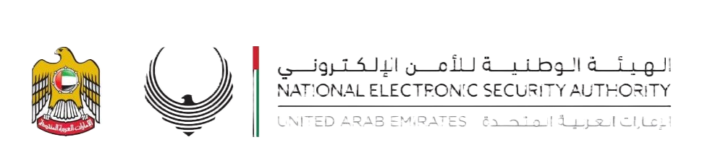






INFORMATION SECURITY RESOLUTION
COMPLIANCE
We deliver compliance services including but not limited to the mentioned standards and regulations
Cyber Security
Framework
National Information Assurance Standard (NIAS)
Abu Dhabi Healthcare Information and Cyber Security
Enterprise Technology Governance & Risk Management Framework
11

Slide 12

OUR CLIENTS

Slide 13


OUR CLIENT INDUSTRIES
TELECOM
FINANCIAL SECTOR
OIL & GAS
We have delivered exceptional services to multiple telecom operators in Middle East and Pakistan
Bank and insurance companies have benefitted from our compliance and security services
We have successfully met the growing demand of cyber security in energy sector
INFORMATION TECHNOLOGY
GOVERNMENT
FMCG
Companies like application developers, service providers also need our expertise and experience
We served the unique cyber security needs of government sector in multiple countries
GRC delivered security services to protect supply chain and ensure resilient IT infrastructures.
13

Slide 14
















Banking Sector
Our selected esteemed partners(Around the globe)
14

Slide 15








TELECOMMUNICATION SECTOR
Our selected esteemed partners (Around the globe)
15

Slide 16






























Fintech
Our selected esteemed partners(Around the globe)
16

Slide 17













Service Providers
Our selected esteemed partners(Around the globe)
17

Slide 18

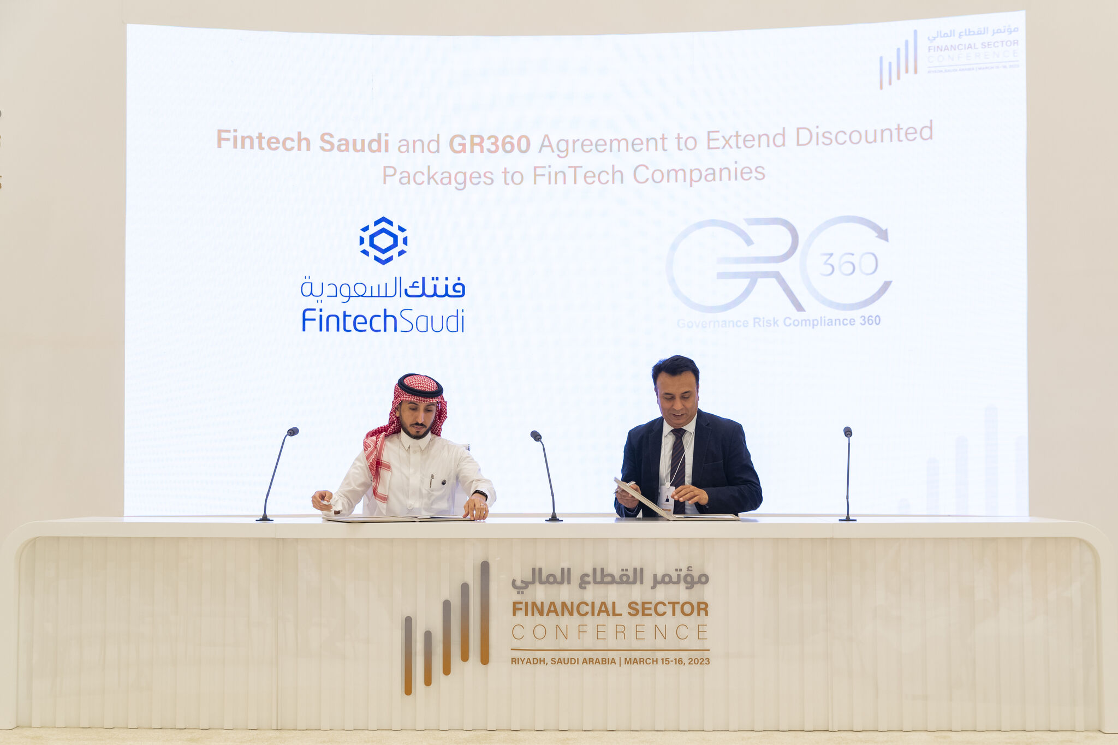
MOU SIGNING WITH FINTECH SAUDI
During the Financial sector conference, held on 15th March 2023 in Riyadh Saudi Arabia, Fintech Saudi | فنتك السعودية and GRC 360 signed a memorandum of understanding to extend discounted packages to fintech companies in KSA.

Slide 19




OUR COMPETITIVE ADVANTAGE
GRC360 is pleased to submit this proposal to enable Client to achieve its objectives. Following are some of our salient features / unique value proposition:
Credentials
Independence
Experienced Resources
0
Our Commitment
Cost Effectiveness
GRC360 will be mobilizing exceptionally talented Cyber Security professionals, leveraging industry knowledge and international best practices.
GRC360 is providing top notch Cyber Security services. We have worked on similar assignments at various organizations in the kingdom. Therefore, we are confident to add-value to Client.
GRC360 views Client as its one of its strategic and prestigious client in the region. Considering this strategic importance, Senior Management of GRC360 is committed to provide its best resources and attention to ensure successful completion of the engagement.
We maintain complete independence in our engagements.
Outstanding services at a cost-effective fee. We optimize our fee by assigning experts and actively involving your team to synergize, avoid duplication. Also, we have heavily discounted our fee to start and cherish our relationship with Client.

Slide 20


PROJECT OVERVIEW

Slide 21

EXECUTIVE SUMMARY
GRC360 renders services related to cyber security for assessing, analyzing and improving information security of our valuable clients. We help in providing solutions that could lead to the development of sustainable, efficient and resilient system.
This proposal provides the holistic approach of methodology to conduct Dummy Company compliance audit against the Dummy Service, by SAMA. Our extensive experience ensures our clients are better able to withstand the impacts of evolving cyber threats and comply with related standards and regulations.
21

Slide 22


PROJECT SCOPE
The project aims at conducting a comprehensive audit to ensure Dummy Company compliance with SAMA Cyber Security Framework. The project scope shall cover the audit of “Company’s” actual implementation assessment against the following domains and their sub domains:
Dummy Bullet Point 1
Dummy Bullet Point 2
Dummy Bullet Point 3

Slide 23


Introduction - SAMA CSF

Slide 24

SAMA CSF - BACKGROUND
To ensure flawless customer experience, confidentiality, integrity and availability of information assets and resilience against cyber threats, SAMA has established its Cyber Security Framework for Saudi Financial Sector to enable its financial institutions to effectively identify and address risks related to cyber security.
The Framework is used by SAMA to periodically assess the maturity level and evaluate the effectiveness of the cyber security controls at SAMA’s Member Organizations, and to compare these with other Member Organizations.
The Framework is based on the SAMA requirements and industry cyber security standards, such as NIST, ISF, ISO, BASEL and PCI.

Slide 25

CYBER SECURITY MATURITY LEVELS
LEVEL 0
LEVEL 1
LEVEL 2
LEVEL 3
LEVEL 4
LEVEL 5
ADAPTIVE
Cybersecurity controls are subject to a continuous improvement plan.
MANAGED AND MEASURABLE
STRUCTURED AND FORMALIZED
The effectiveness of the cybersecurity controls are periodically assessed and improved when necessary.
This periodic measurement, evaluations and opportunities for improvement are documented.
REPEATABLE BUT INFORMAL
Cybersecurity controls are defined, approved and implemented in a structured and formalized way.
The implementation of cybersecurity controls can be demonstrated.
AD-HOC
The execution of the cybersecurity control is based on an informal and unwritten, though standardized, practice.
Cybersecurity controls are not or partially defined.
Cybersecurity controls are performed in an inconsistent way.
Cybersecurity controls are not fully defined.
AD-HOC
No documentation.
There is no awareness or attention for certain cybersecurity control.

Slide 26
3.2.2 Regulatory Compliance
3.2.3 Compliance with (inter)national industry standards
3.2.4 Cyber Security Review
3.2.5 Cyber Security Audit
3.2.1 Cyber Security Risk Management
3.2 Cyber Security Risk Management and Compliance
3.1 Cyber Security Leadership and Governance
3.1.2 Cyber Security Strategy
3.1.3 Cyber Security Policy
3.1.4 Cyber Security Roles and Responsibilities
3.1.5 Cyber Security in Project Management
3.1.6 Cyber Security Awareness
3.1.7 Cyber Security Training
3.1.1 Cyber Security Governance
3.3.5 Identity and Access Management
3.3.1 Human Resources
3.3 Cyber Security Operations and Technology
3.3.2 Physical Security
3.3.3 Asset Management
3.3.4 Cyber Security Architecture
3.3.6 Application Security
3.3.7 Change Management
3.3.9 Cryptography
3.3.10 Bring Your Own Device (BYOD)
3.3.11 Secure Disposal of Information Assets
3.3.12 Payment Systems
3.3.13 Electronic Banking Services
SAMA CSF
-
DOMAINS
3.1.6 Cyber Security Awareness
3.1.7 Cyber Security Training
3.1.5 Cyber Security in Project Management
3.4 Third Party Cyber Security
3.3.14 Cyber Security Event Management
3.3.15 Cyber Security Incident Management
3.3.16 Threat Management
3.3.13 Electronic Banking Services

Slide 27
DELIVERY METHODOLOGY

Slide 28
AUDIT METHODOLOGY
For the proposed project scope, GRC360’s shall conduct audit against all the relevant controls pertaining to SAMA MVC CRFR:
Context Building
Audit
Sharing of Evidences
Review Evidences
Interim Audit Report
Final Audit Report

Slide 29
SAMA CSF AUDIT METHODOLOGY
All the aspects of our methodology are well synchronized to reach project’s objectives. We ensure a holistic view while tackling the daunting mission of cybersecurity in the unique financial environment of KSA.
Consultant has an extensive experience of providing support for achieving SAMA CSF Maturity Level 3.
CSF standard has in total 250 controls – thus at the minimum 500 evidences shall be requested however, there can be more evidences needed and upon request client shall furnish those.
Following cyber security areas and their respective controls shall be covered during the CSF Audit :
Cyber Security Leadership and Governance
Cyber Security Risk Management & Compliance
Cyber Security Operations and Technology
Third Party Cyber Security

Slide 30
CSF WALKTHROUGHS
Session | Attendees | Scope
Access Control & Infrastructure | System Administrators (Windows/Linux) Cloud Platform Administrators (e.g., OCI, AWS, Azure) Container/Kubernetes Administrators Network Administrators Application Owners (for critical apps) | Inventory & Architecture User Provisioning IAM Settings Privilege Management Backup and Restoration
Change Management | Change Coordinator / CAB (Change Advisory Board) Representative System Administrators / DevOps Leads (those who perform changes) Network Administrators | Real Change Example Workflow Demonstration Implementation Verification Security Considerations Incident Reporting
Secure SDLC | Development Team Lead / DevOps Engineers QA or Testing Team Representative (if separate) Security/DevSecOps (if applicable) | Code Repositories Pipeline Security Checks Code Review Process Vulnerability Handling
SIEM and Incidence Response | SOC Team / Security Operations SIEM Administrators / Analysts | Real-Time Dashboard Correlation Rules Incident Handling Log Retention Incident Reporting.
Vulnerability Assessment and Patching | Security Engineer / VA Tool Owner (e.g., Nessus, Qualys) Patch Management Team / System Administrators Network Administrators | Vulnerability Scan Demonstration High-Severity Findings Patching Console Validation Backup Linkage

Slide 31


PROJECT DELIVERABLES

Slide 32
PROJECT DELIVERABLES
Project | Activity | Deliverable(s)
SAMA CSF Audit | 1. Dummy Activity 1 2. Dummy Activity 2 3. Dummy Activity 3 | 1. Dummy Deliverable 1 2. Dummy Deliverable 2 3. Dummy Deliverable 3

Slide 33


PROJECT TIMELINE

Slide 34

PROJECT TIMELINE
Estimated duration: 8 Calendar Weeks (May vary depending upon the client’s response)
Weekly Breakdown of High-Level Project Phases
W1 |  |  |  |  | W2 |  |  |  |  | W3 |  |  |  |  | W4 |  |  |  |  | W5 |  |  |  |  | W6 |  |  |  |  | W7 |  |  |  |  | W8
Dummy Timeline 1
Dummy Timeline 2
Dummy Timeline 3
Pre-Audit Walkthroughs, Evidence Evaluations
Gap Assessment with Report to Follow
Final Audit Assessment and Evaluation against SAMA CSF maturity Levels
With Final audit report to follow
Auditing Company

Slide 35

PROJECT MANAGEMENT

Slide 36

PROJECT MANAGEMENT METHODOLOGY
GRC360’s methodology is based on wide professional experience and in-depth knowledge of project management. Best practices are embedded across the project management activities from initiation to closing.
INITIATION
EXECUTION
CLOSING
PLANNING
MONITORING & CONTROL

Slide 37





OUR PROJECT MANAGEMENT MODEL
GRC360’s project management approach is based upon four-step model PDCA (Plan, Do, Check, Act), which is a powerful method for implementing continual development and issue solving:
Planning involves identification of problem, and establishment of goals and target results.
Doing involves plan execution, and development and implementation of potential solution(s).
Checking measures of the effectiveness of a solution by studying the results.
Acting involves adjustment to achieve the intended results.
PLAN
DO
ACT
CHECK

Slide 38


PROJECT TRACKING AND MONITORING
GRC360 ensures that the clients’ corporate goals and business benefits are realized through a controlled, well-managed, visible set of activities to achieve the desired results.
GRC360 has an experience of delivering full spectrum of services at every phase of project life cycle.
The Project Manager will track, review, and regulate the progress and performance of the project; identify any areas in which changes to the plan are required, initiate the corresponding changes and publish, maintain and communicate the risks to Dummy Company’s management.

Slide 39





PROJECT DOCUMENTATION
Project Plan
An elaborate project plan comprising of Gantt chart and project dashboard will be developed and updated by GRC360.
Work Breakdown Structure
WBS of project tasks will be developed that will cover task dependencies, responsibilities and duration.
Communication Plan
A communication plan to ensure timely project related information disseminate to relevant stakeholders.
RACI Matrix
Clearly defined roles and responsibilities will be developed.

Slide 40

OUR TEAM
Experienced Certified Professionals
Our team members are seasoned consultants having extensive and proven experience of providing premium consulting services to clients ranging from financial to government organizations and spanning from Asia, Middle East to Europe.

Slide 41




















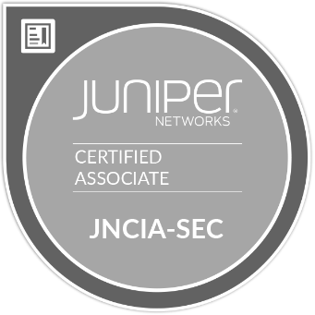





QUALIFICATIONS & CERTIFICATIONS
Our Consultants have the following active certifications:

Slide 42


FINANCIALS

Slide 43


FINANCIALS
Sr. No. | Deliverables | Amount SAR
1 | Dummy Deliverable 1 | $100
2 | Dummy Deliverable 2 | $200
3 | Dummy Deliverable 3 | $300
Total |  | $1150.00
Total without VAT |  | $1000.00
Payment Terms:
Price above does not include KSA VAT,
40% on signing on and Awarding
30% after 1 month of PO
30% with project sign off

Slide 44

DUBAI, UAE
RIYADH, KSA
DOHA, QATAR
MANAMA, BAHRAIN
MELBOURNE, AUSTRALIA
ISLAMABAD, PAKISTAN
CONTACT US
WEBSITE
www.grc360.net
PHONE NUMBER
+966 503110519 (KSA)
+61 412738906 (Australia)
EMAIL ADDRESS
info@grc360.net

